Slide 1
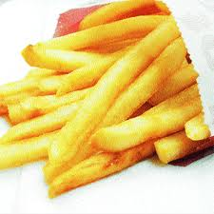
Metabolic Diseases Lesson 4.5
Seeing through the static –
How do we identify correlations in real-life data?

Slide 2
Do Now
What are some ‘good’ foods?
What are some ‘bad’ foods?

Slide 3
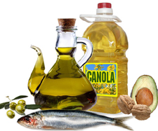
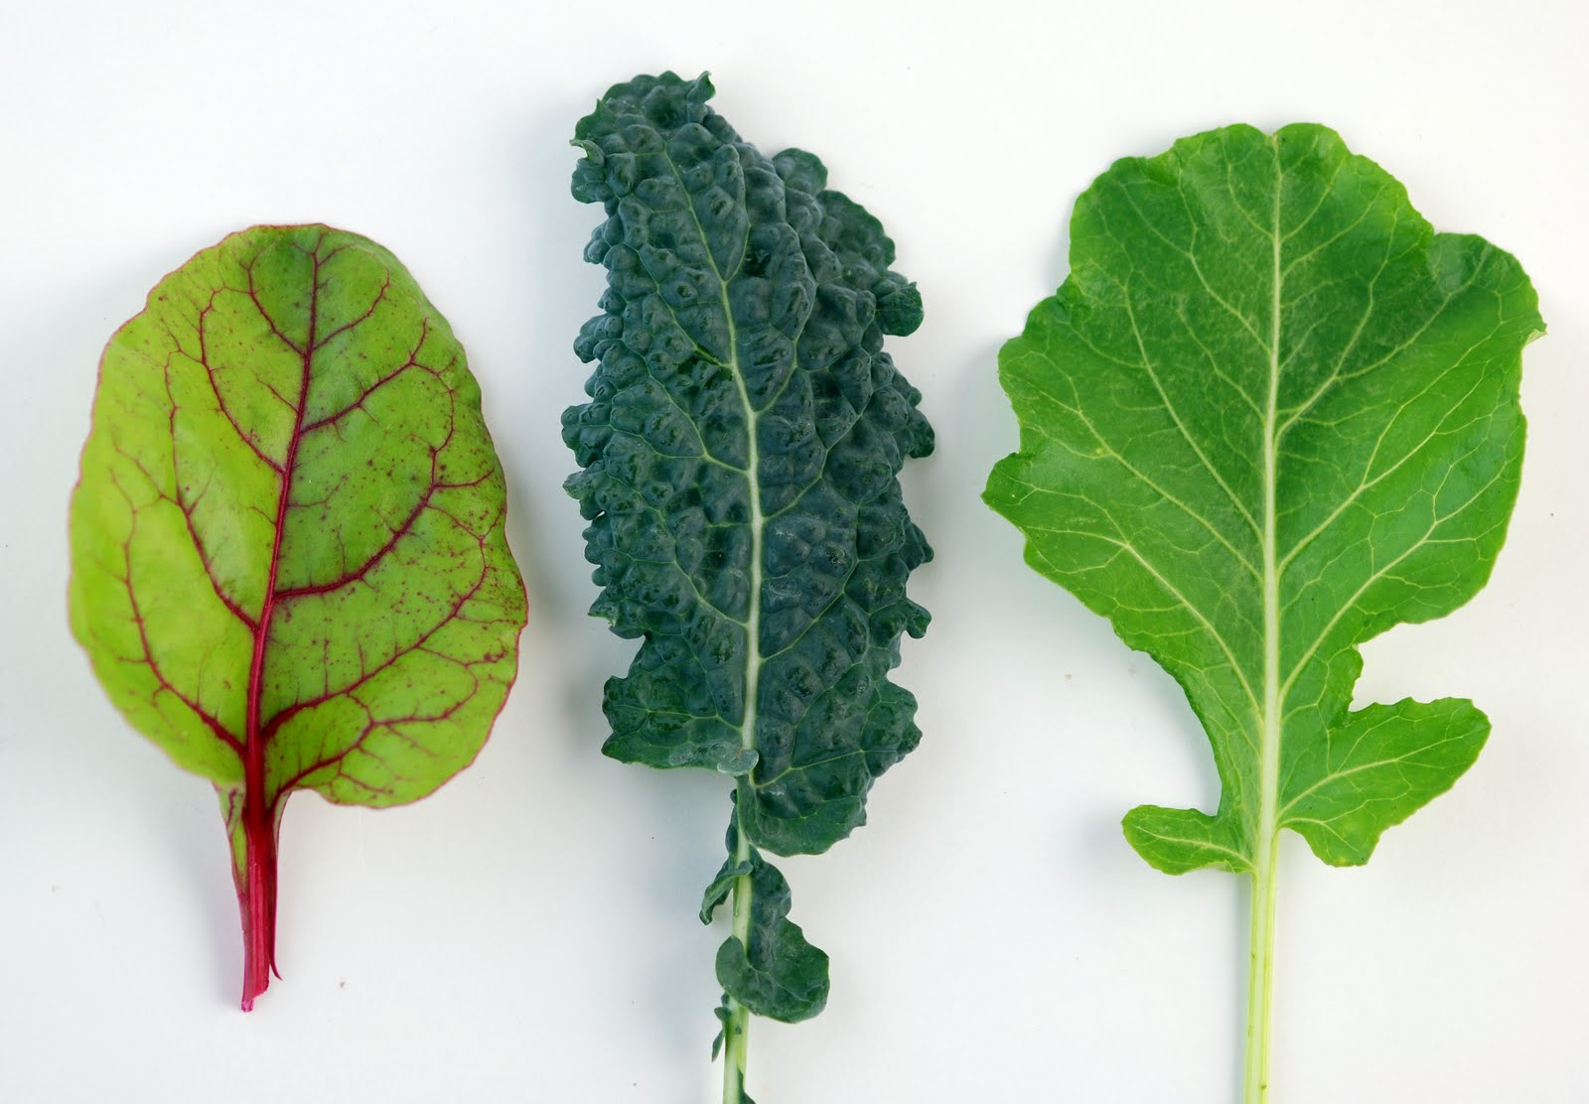
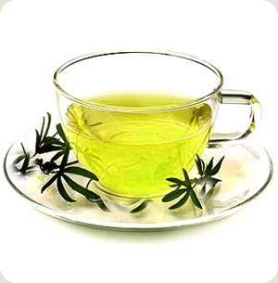
‘Good’ foods

Slide 4
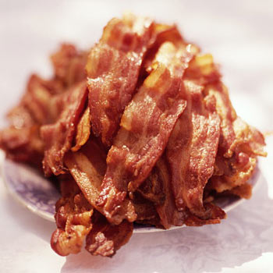
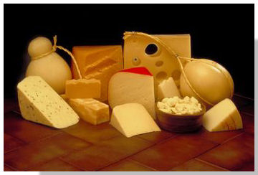
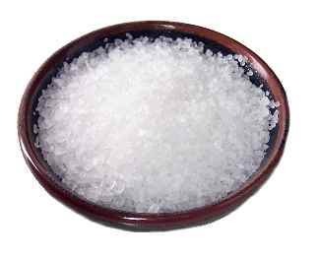
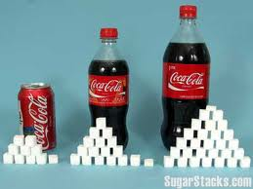
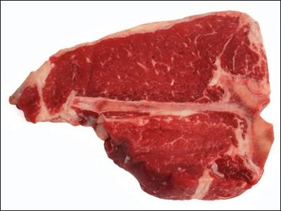
‘Bad’ foods

Slide 5
Do Now
What would you expect to ‘see’ if a person eats lots of the ‘bad’ foods?

Slide 6
‘Bad’ foods and disease

Slide 7
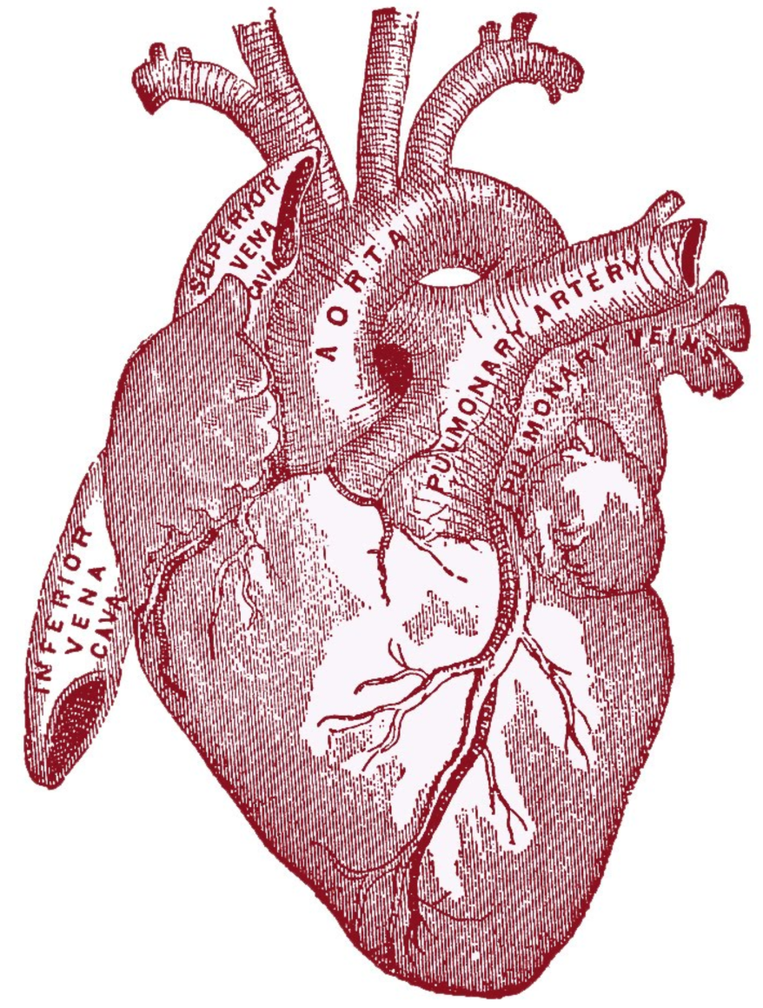
Activity: Seeing through the static – How do we identify correlations in data?
Analyzing primary data from the Framingham heart study

Slide 8
Wrap Up
Did any of the correlations that you investigated surprise you? Why?

Slide 9
Homework
Complete the worksheet.

